Slide 1
The basics of Markdown

Slide 2
What is Markdown?
Markdown is a lightweight markup language
Create formatted text using a plain-text editor
Main goal is to make writing for the web more accessible, prioritizing readability and ease of use
Created by John Gruber and Aaron Swartz in 2004

Slide 3
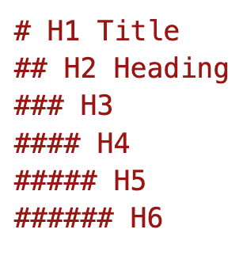
Headings
Use 1-6 hash (#) symbols to indicate the heading level
One H1 per markdown file. This is the title.
Avoid using bold or other markup in headers

Slide 4
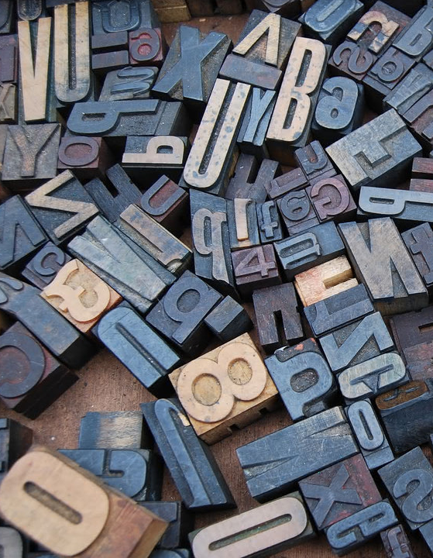
Formatting
Letter case
PowerShell keywords and operators should be all lowercase
Use proper (Pascal) casing for cmdlet names and parameters
Backtick syntax elements within a paragraph
Cmdlet names & Variables - `Verb-Noun`, `$counter`
Syntactic examples `Verb-Noun -Parameter`
File paths and URLs - `C:\Program Files\PowerShell`, `/usr/bin/pwsh`
Property or parameter values
Bold is used for semantic markup, not emphasis - use asterisks **
Property & Parameter names
Class names, object or type names
Module names
Italics - use underscore _
Only used for emphasis, not for semantic markup
Use when defining a term for the first time

Slide 5
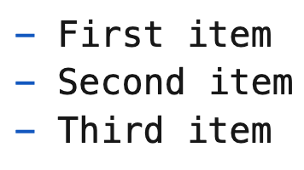
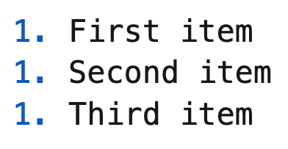
Lists
Unordered lists
Use the hyphen character (-) for list item bullets
Ordered list
Use number 1 for all list items

Slide 6
Links and images
Links
[title](https://www.example.com)
Images
![alt text](image.jpg)

Slide 7
Tables

Slide 8
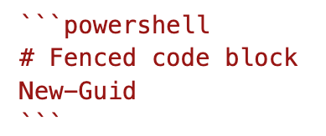
Code
Inline code
Use `Get-Help` to learn how to use a command in PowerShell.
Fenced code block

Slide 9
Line length
Use semantic line breaks to limit line length
Conceptual = 100 characters
Reference = 100 characters
About = 80 characters
Reflow Markdown extension
No hard tabs - use spaces only
No trailing spaces on lines

